Slide 1
Automation System Testing using Selenium Cucumber and AWS CI/CD Implementation
Student: Lê Thuý Lan (LANLTFX01326)
Instructor: Lương Trung Kiên

Slide 2
Contents
Report 1 Introduction
Report 1: Comparison
Report 1: Context Diagram
Report 2: Critical Dependencies and risks
Report 2: Software Development model
Report 2: Project Milestones and deliverables
Report 2: Project Scope
Report 3: Software Specific Requirements CI/CD
Report 3: Software Specific Requirements – Automation use case example
Report 4: Component Diagram (AWS)
Report 4: Component Diagram (Selenium)
Report 4 Sequence Diagram (Selenium Cucumber)
Report 4: Sequence Diagram
Report 4: AWS detailed resource diagram
Report 5: Test Strategy and acceptance criteria
Report 5: Test Case List – Detailed Test Case
Report 5: Test Report
Report 5: Bug Report Sample
Demo

Slide 3
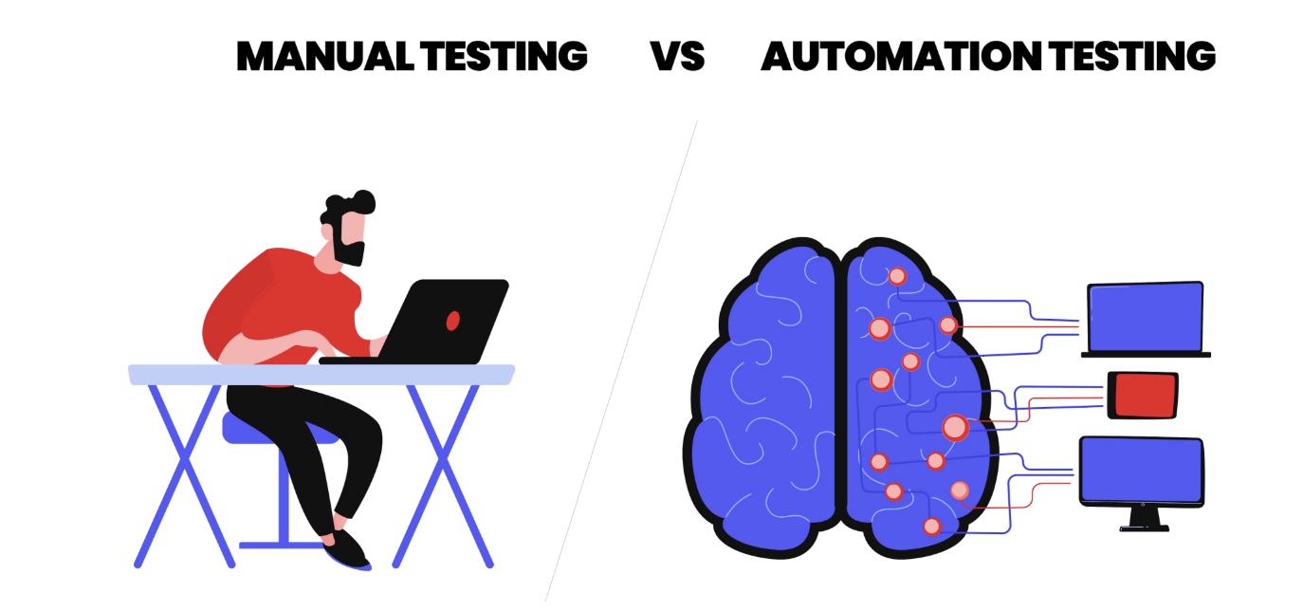
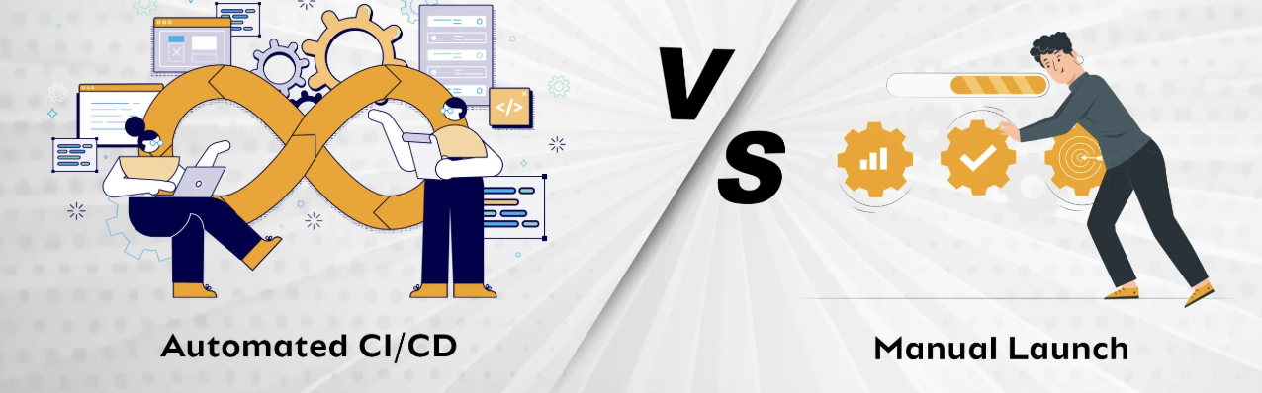
Report 1: Inspiration and comparison
Current system:
System tested manually for a web application called “Online Book Store”. Manual regression testing is performed every release which is time and effort-consuming.
Deployment environment is created and configured manually, the process is implemented manually from .jar file built locally and uploaded to AWS Elastic Bean Stalk, auto deployment is not available

Slide 4
Report 1: Introduction
CI/CD is very beneficial in software project
+ It reduces manual errors, ensure consistent and repeatable processes in build, test, deploy
+ Early detect bugs, improve quality and confidence
+ Faster release cycles, higher product stability and reliability (frequent automated regression testing, easier rollbacks in case of failure, reduce downtime and deployment-related issues)
+ Better team collaboration
Automation testing plays important role in software project
+ Faster testing (than manual testing, support quick feedback during development
+ Repeatability (support regression testing for old functions when developing new functions)
+ Enable CI/CD (a part of CI/CD pipeline)
+ Improve product quality (early bugs detection)

Slide 5
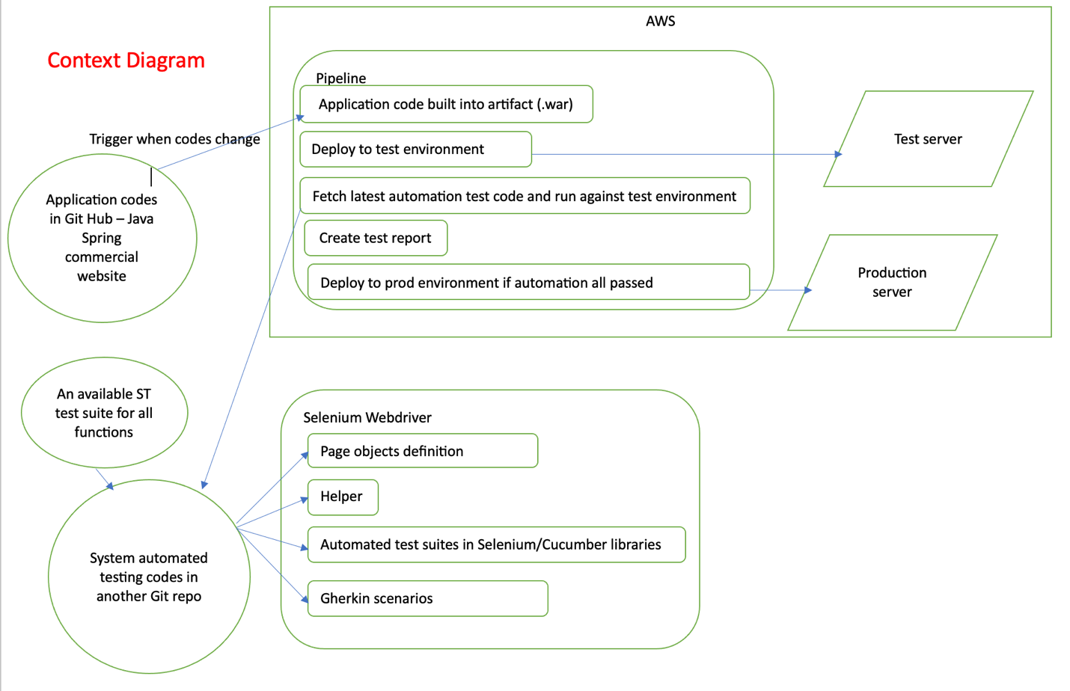

Slide 6


Report 2: Critical Dependencies and risks
Nox | Dependency | Expected Delivery Date
1 | Test server is setup to run automated system test | 15-Jun-2025
2 | Production server is set up ready for release deployment as a part of CI/CD | 30-Jun-2025
3 | Manual test suite for online bookstore is ready for automation development | 13-Apr-2025
No | Risks | Prevention | Remark
1 | AWS server is down (rare but can happen) | Deployment in different regions and have fallback mechanism | Accept this risk because that prevention method is costly
2 | Using Bean stalk for default URL, every time setting up a new environment, there is a new URL. Therefore, automation code also needs to change to target URL to test | Buy a domain to use. | Accept the risk because this project is using default AWS domain

Slide 7
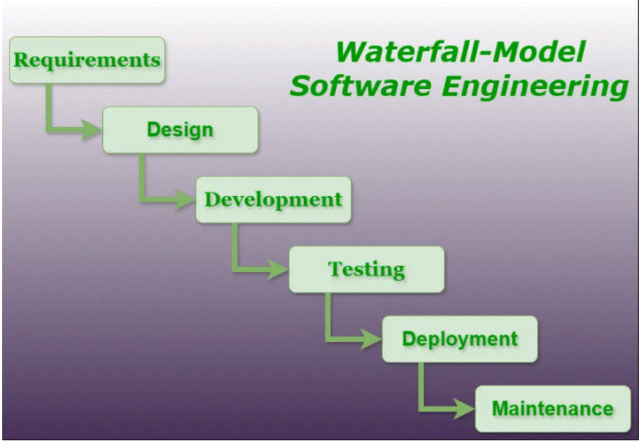
Report 2: Software Development model
Requirement | Analyze requirements of the project, the current manual test suite, identify scopes, develop strategy to solve the problem.
Design | Design solution for CI/CD infrastructure Design contents and solution for automation mechanism.
Development | Set up CI/CD resources Write automation codes
Testing | Test the implementation of CI/CD system Execute automation code and retrieve reports
Deployment | Release to production environment
Maintenance | Monitor health check of AWS console via real-time records, Manage monthly costs Maintain and enhance, update automation codes

Slide 8
Report 2: Project Milestones and deliverables
No | Stage | Committed Delivery | Deliverables Description
Initiation
1 | Project registration Initial Project Overview report | 13-Apr-2025 | Project registration form Report 1: Context report
Definition
2 | Software Project Management Plan | 18-Apr-2025 | Report 2: Software Project Management Plan
Solution
3 | Design Interim release 1 | 25-Apr-2025 | Report 3: Software Requirement Specifications
4 | Design Interim release 2 | 02-May-2025 | Report 4: Project Design Document
Construction
5 | Construction Interim release 1 | 15-June-2025 | AWS CI/CD Infrastructure configuration
6 | Construction Interim release 2 | 30-June-2025 | Automation source codes
7 | UAT release | 02-Jul-2025 | Deployment to UAT environment System test report
Transition
7 | Final release | 19-Jul-2025 | Deployment to Production environment Project documentation
Termination
8 | Post-mortem report | 05-Aug-2025 | Final project documents
9 | Acceptance notes | 06-Aug-2025

Slide 9
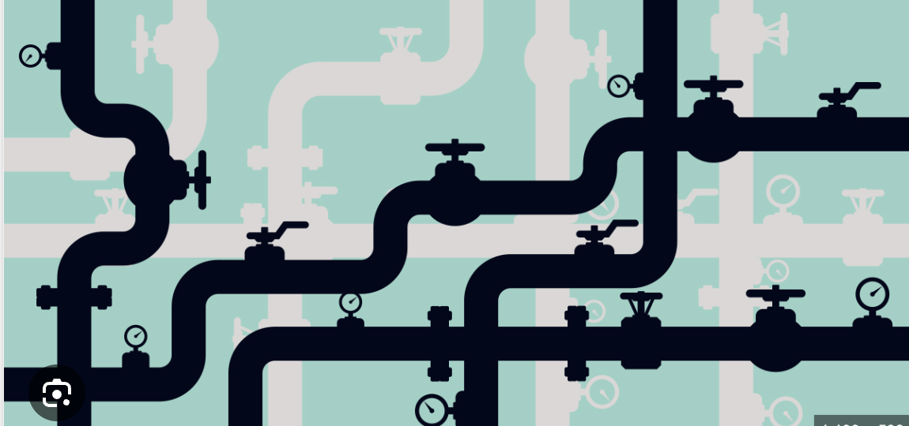
Report 2: Project Scope
Online Bookstore application codes build and deployment
+ As a part of CI/CD, when new changes in application codes are deployed to GitHub, AWS shall be notified and pull codes to the AWS repository.
+ Codes built from AWS source artifact and executable artifacts are created in AWS repository (.jar)
Automated Regression System Testing implementation
+ Normal user: validate user abilities to navigate to home page to browse details, search for book titles, add books to cart, go to cart and view details, remove from cart, delete all, check out and place order.
+ Admin: validate admin abilities sign in with username/password, view books details, search books, edit details and save, delete books, view order details, log out from Admin orders page, log out.
Complete and Maintain CI/CD pipeline (5 steps) for continuous integration and continuous delivery
+ Pull application and automation source codes from GitHub as source artifacts.
+ From source artifacts, build into executable artifacts
+ Deploy source artifact to UAT environment.
+ Run automation test
+ Review and release source artifact to production environment.

Slide 10
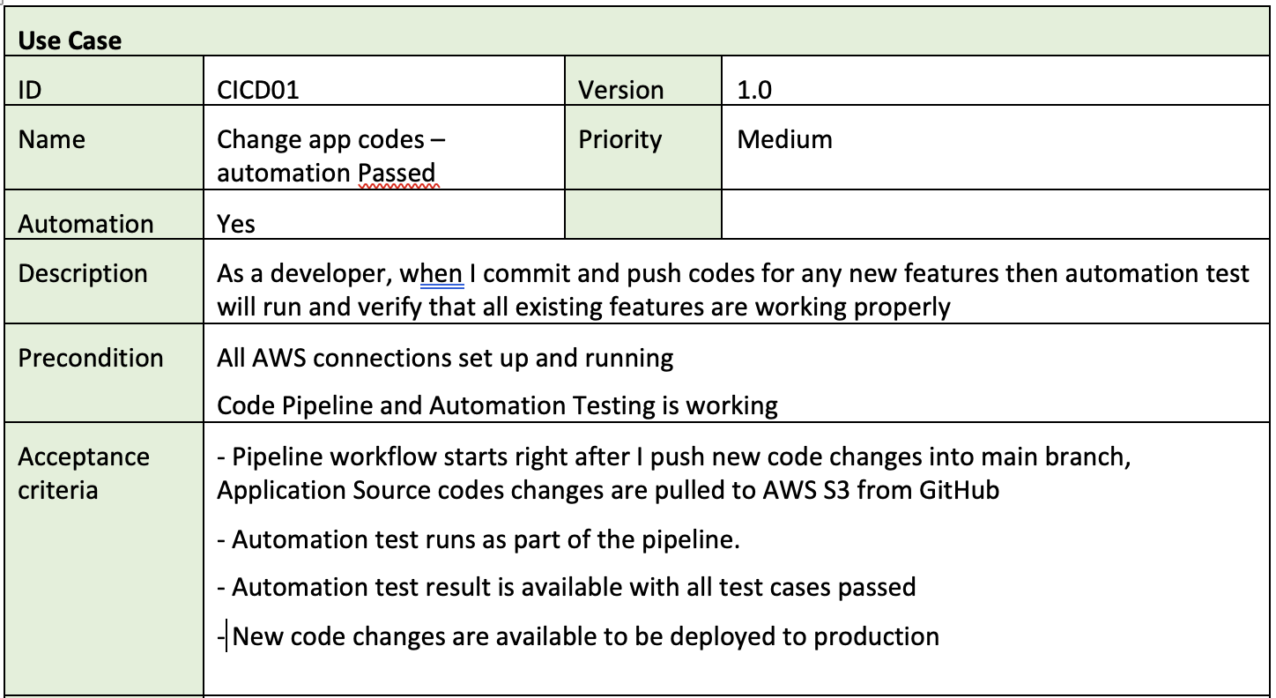
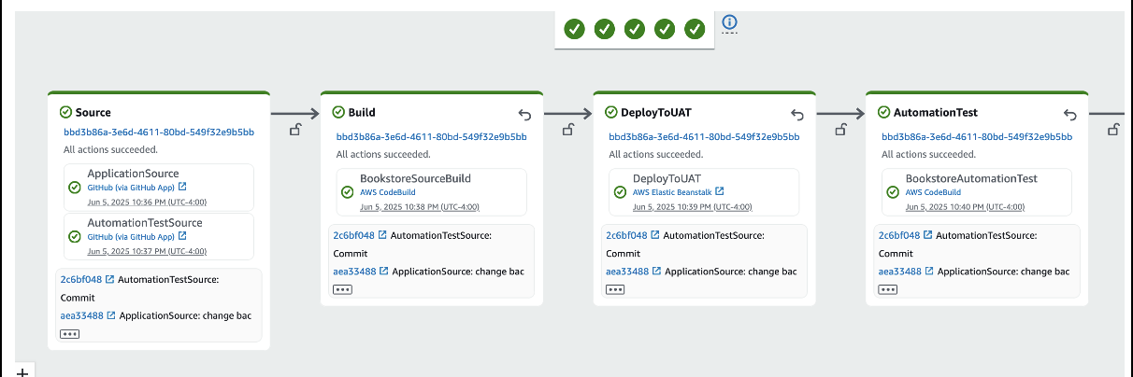
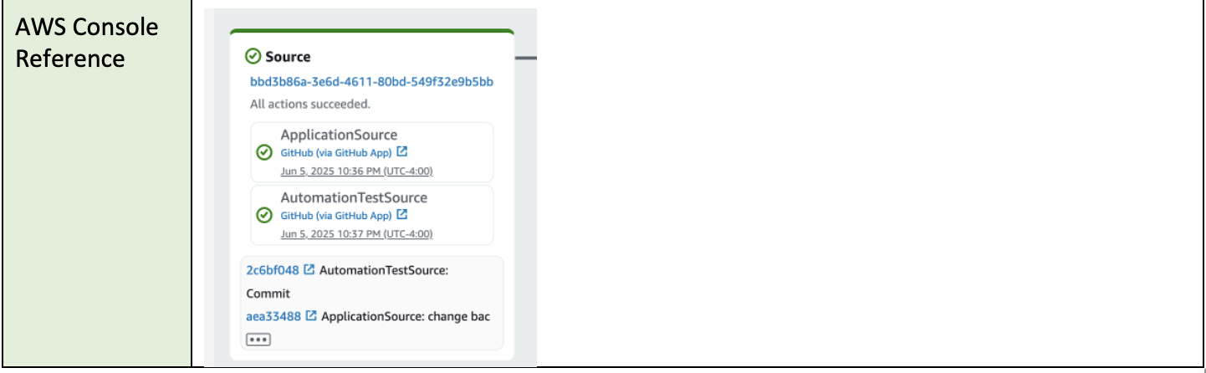
Report 3: Software Specific Requirements
(CI/CD requirement example)

Slide 11
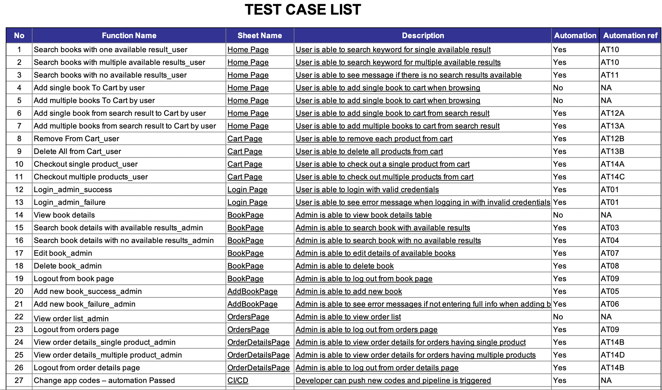
Report 3: Software Specific Requirements – Automation test case list

Slide 12
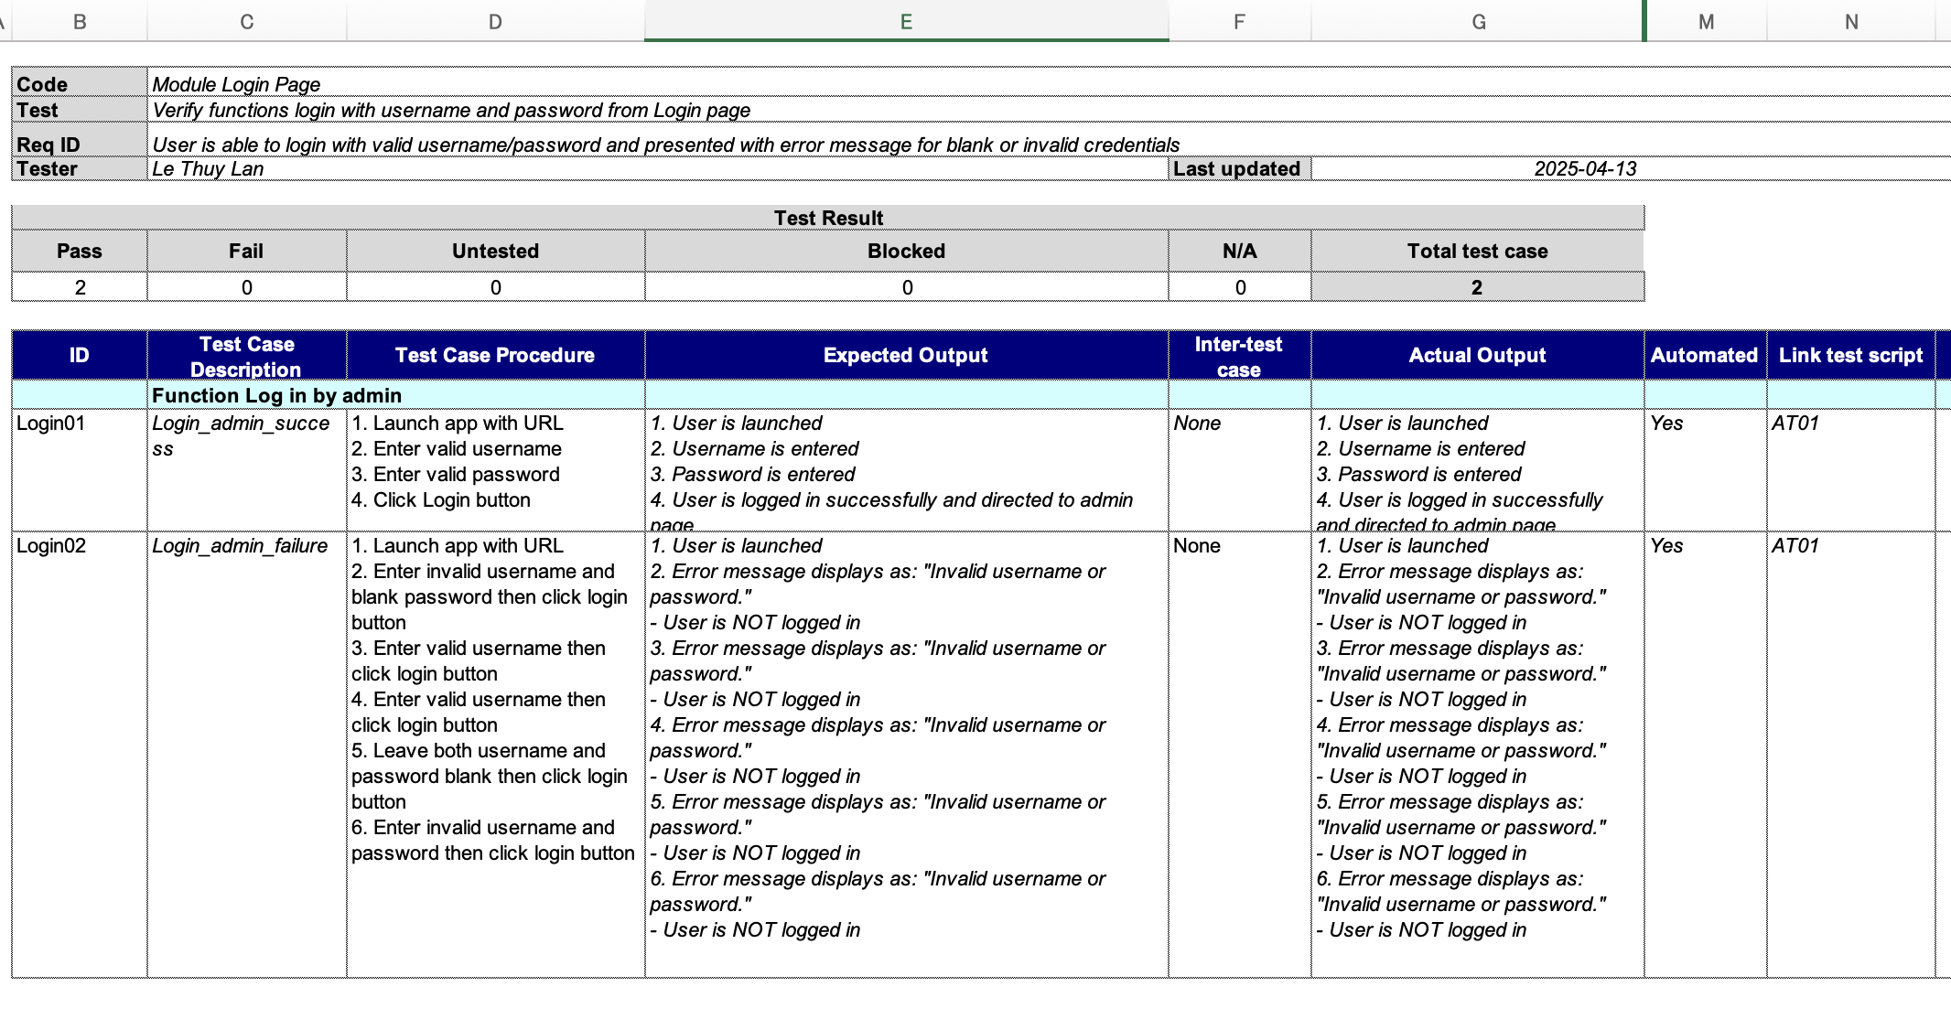
Report 3: Software Specific Requirements – Automation test case example

Slide 13
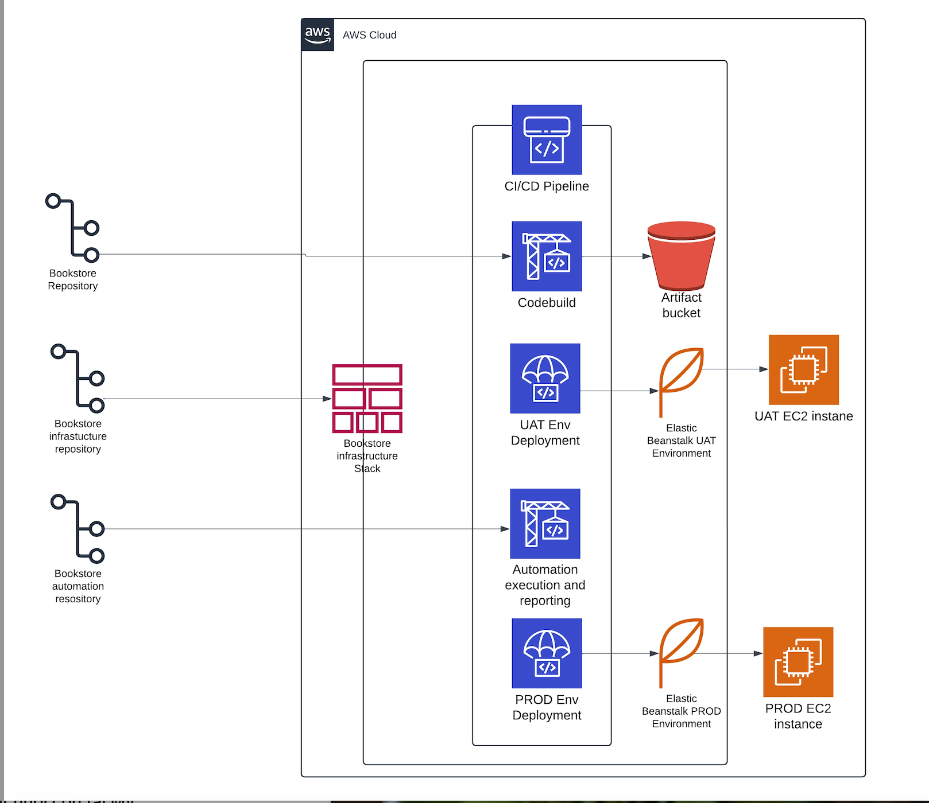
Report 4: Component Diagram
(AWS)

Slide 14
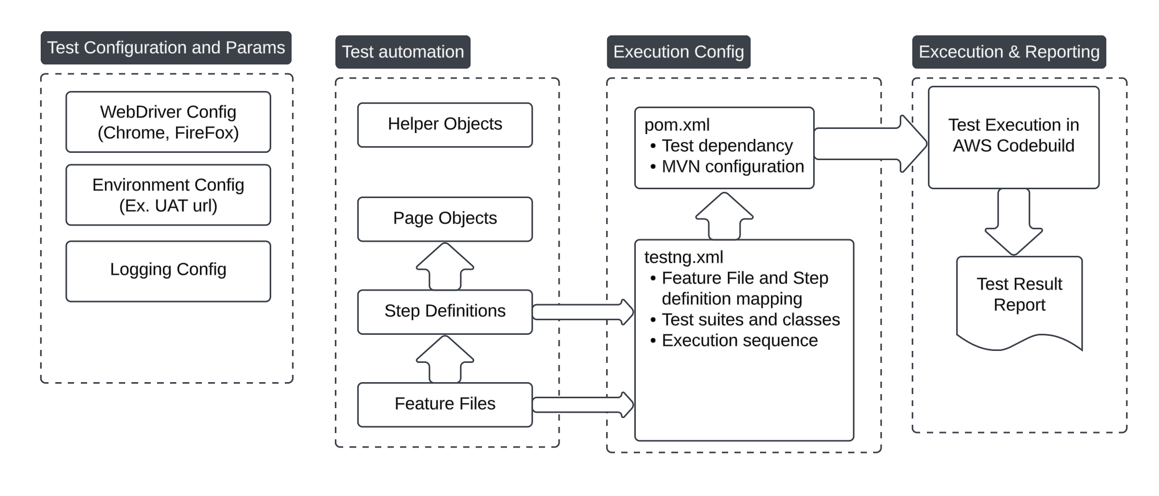
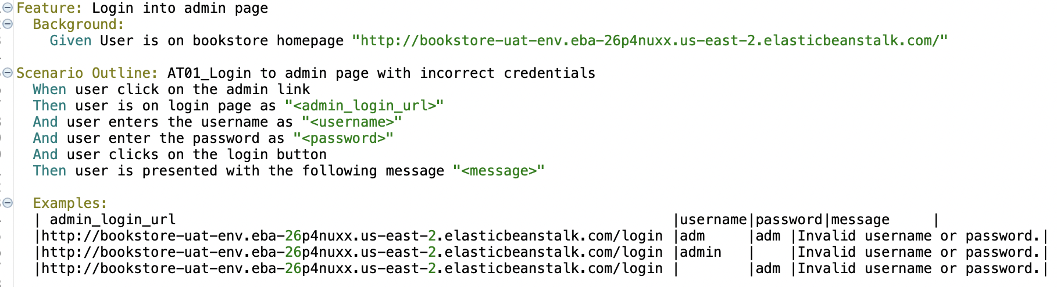
Report 4:
Component Diagram
(Selenium Cucumber)

Slide 15
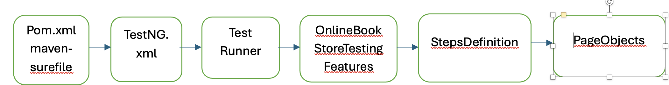
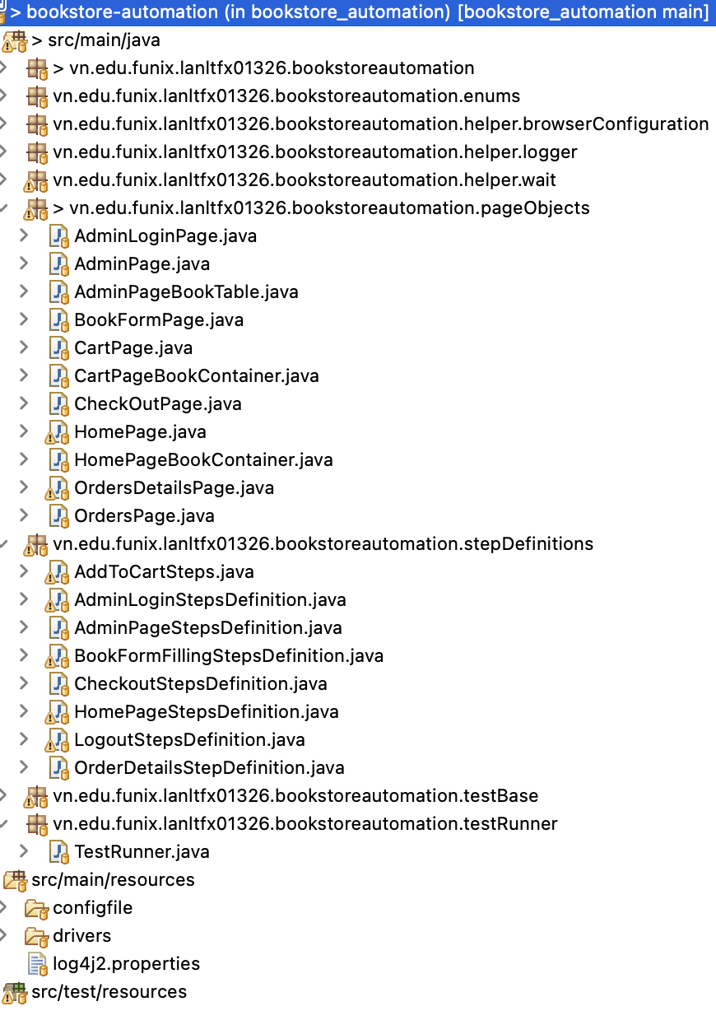
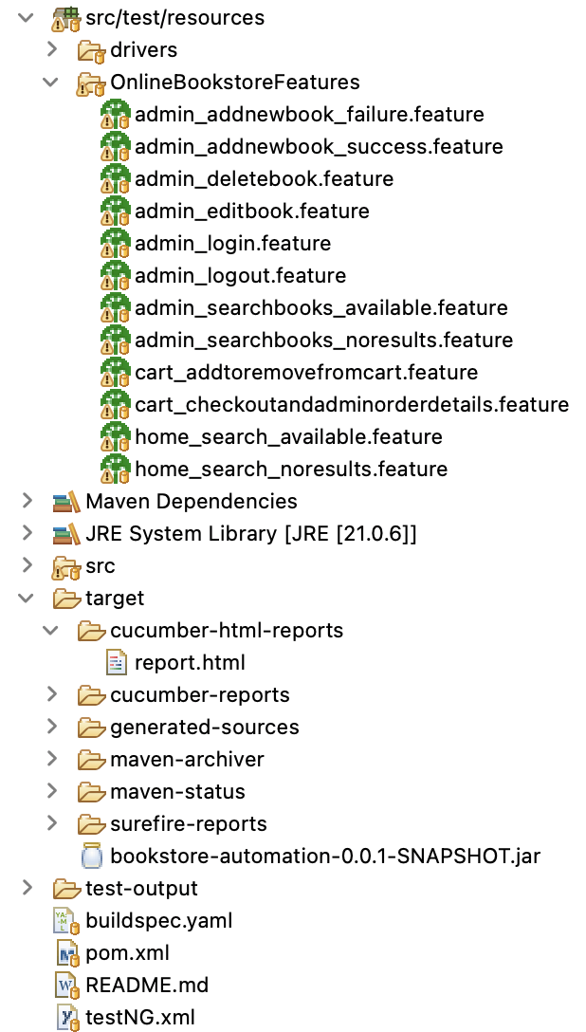
Report 4
Sequence Diagram
(Selenium Cucumber)

Slide 16
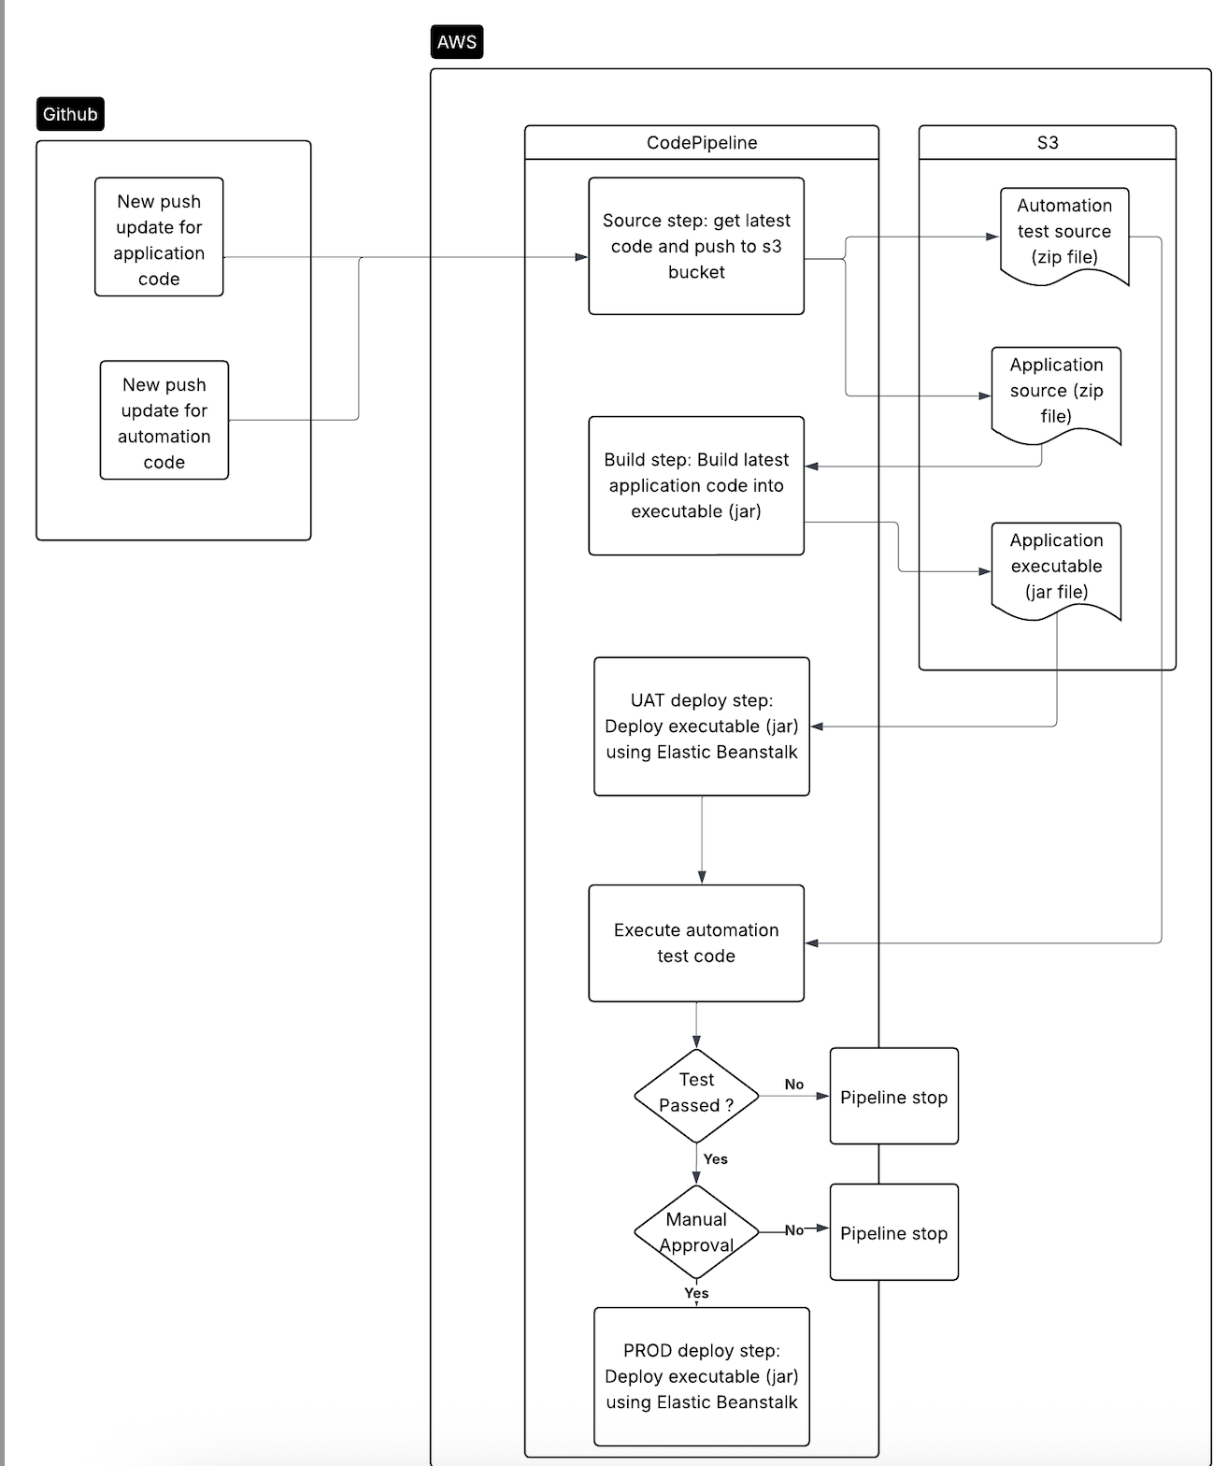
Report 4: Sequence Diagram
(AWS)

Slide 17
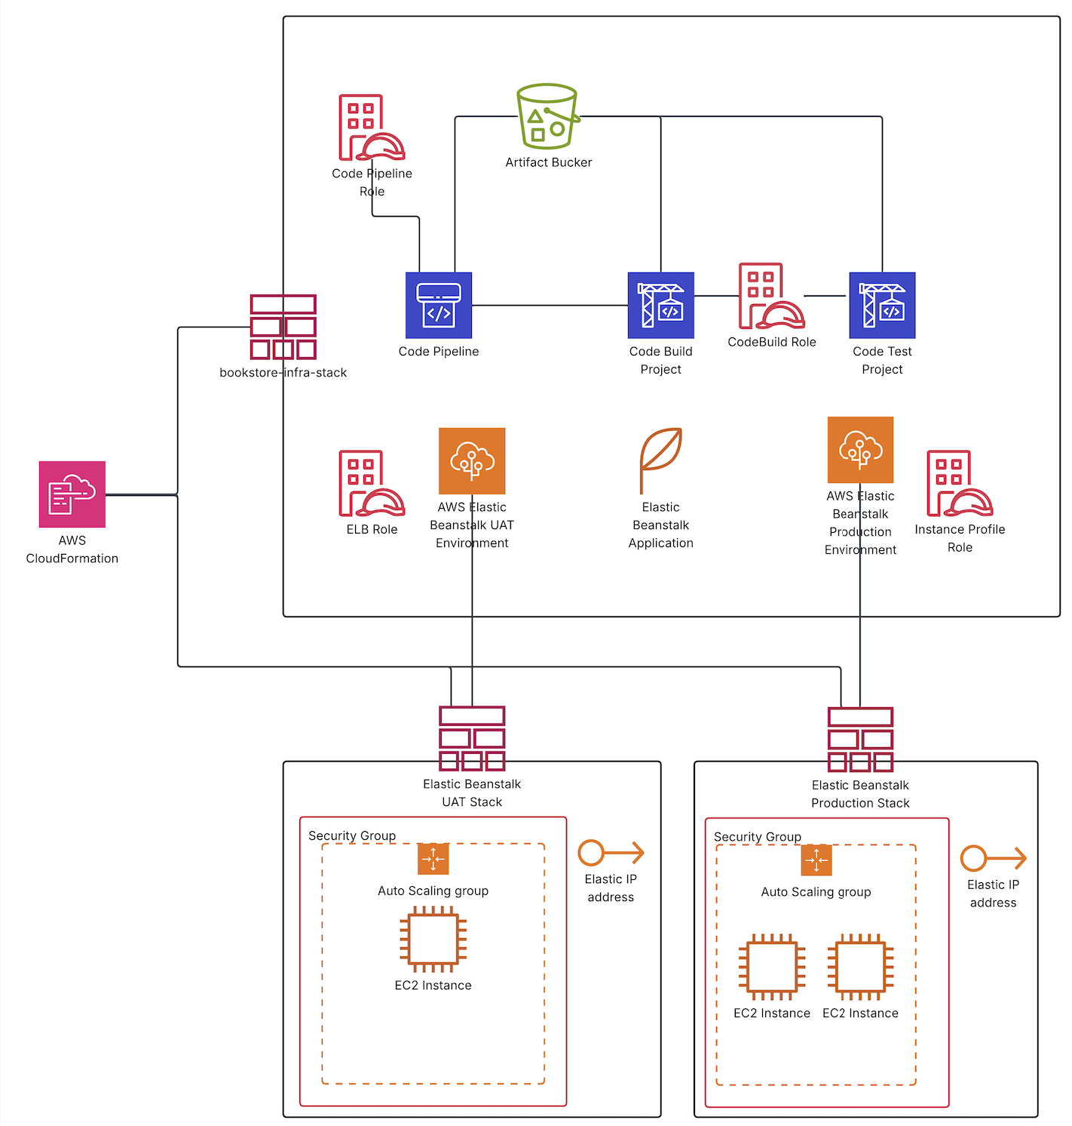
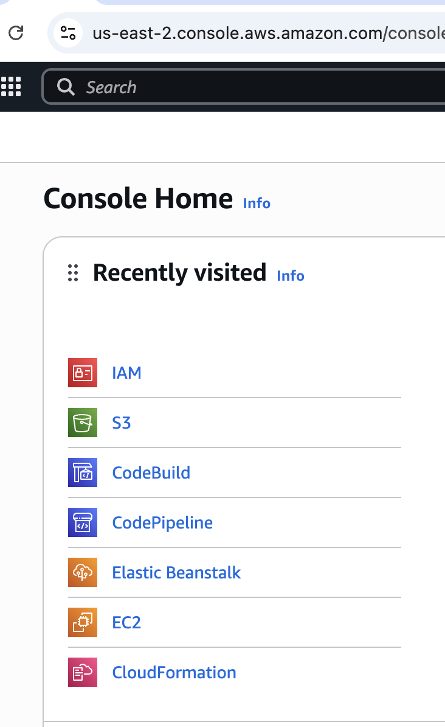
Report 4: AWS detailed resource diagram

Slide 18
Report 5: Test Strategy and acceptance criteria
Should automate | Should not automate or Low priority
- High risk - Business critical test cases - Test cases that are executed repeatedly - Test cases that are very tedious or difficult to perform manually - Test cases which are time consuming and need multiple data sets. | - Test cases that are newly designed and not executed manually at least once - Test cases for which the requirements are changing frequently - Test cases which are executed on ad-hoc basis - Test cases that are extremely complex
Test Level | Main Tasks | Entry Criteria | Suspension Criteria | Resumption Criteria | Exit Criteria
System Test | Verifying that the system operates as specified in the requirements specification Achieving a certain level of system requirements coverage (80%) | Successful completion of integration testing process. Priority bugs found during previous testing activities has been fixed and closed. - System testing environment is available. - Test cases, test scripts, test data is ready | The build contains many serious defects which seriously or limit testing progress. - Significant change in requirements raised by client - Software/Hardware problems - Assigned resources are not available when needed by test team | Issue due to which suspension occurs gets resolved. | All planned automated Test Cases have been executed 100% - 100 % automated regression system test cases have to be passed - Only Cosmetic defects can be accepted

Slide 19
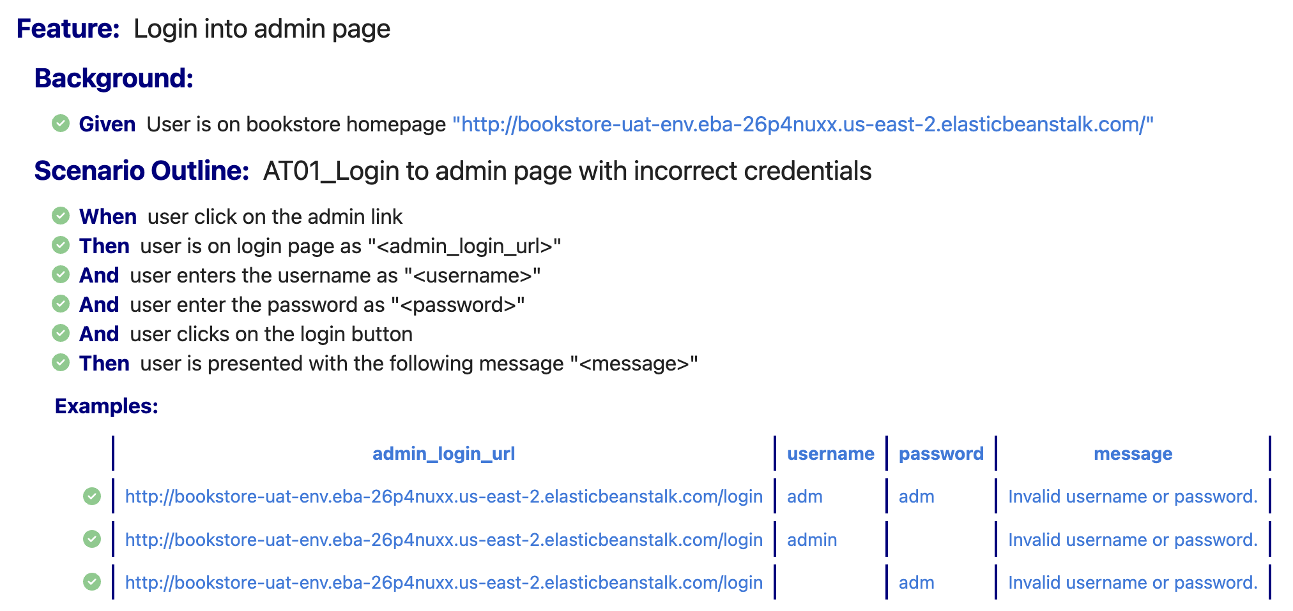
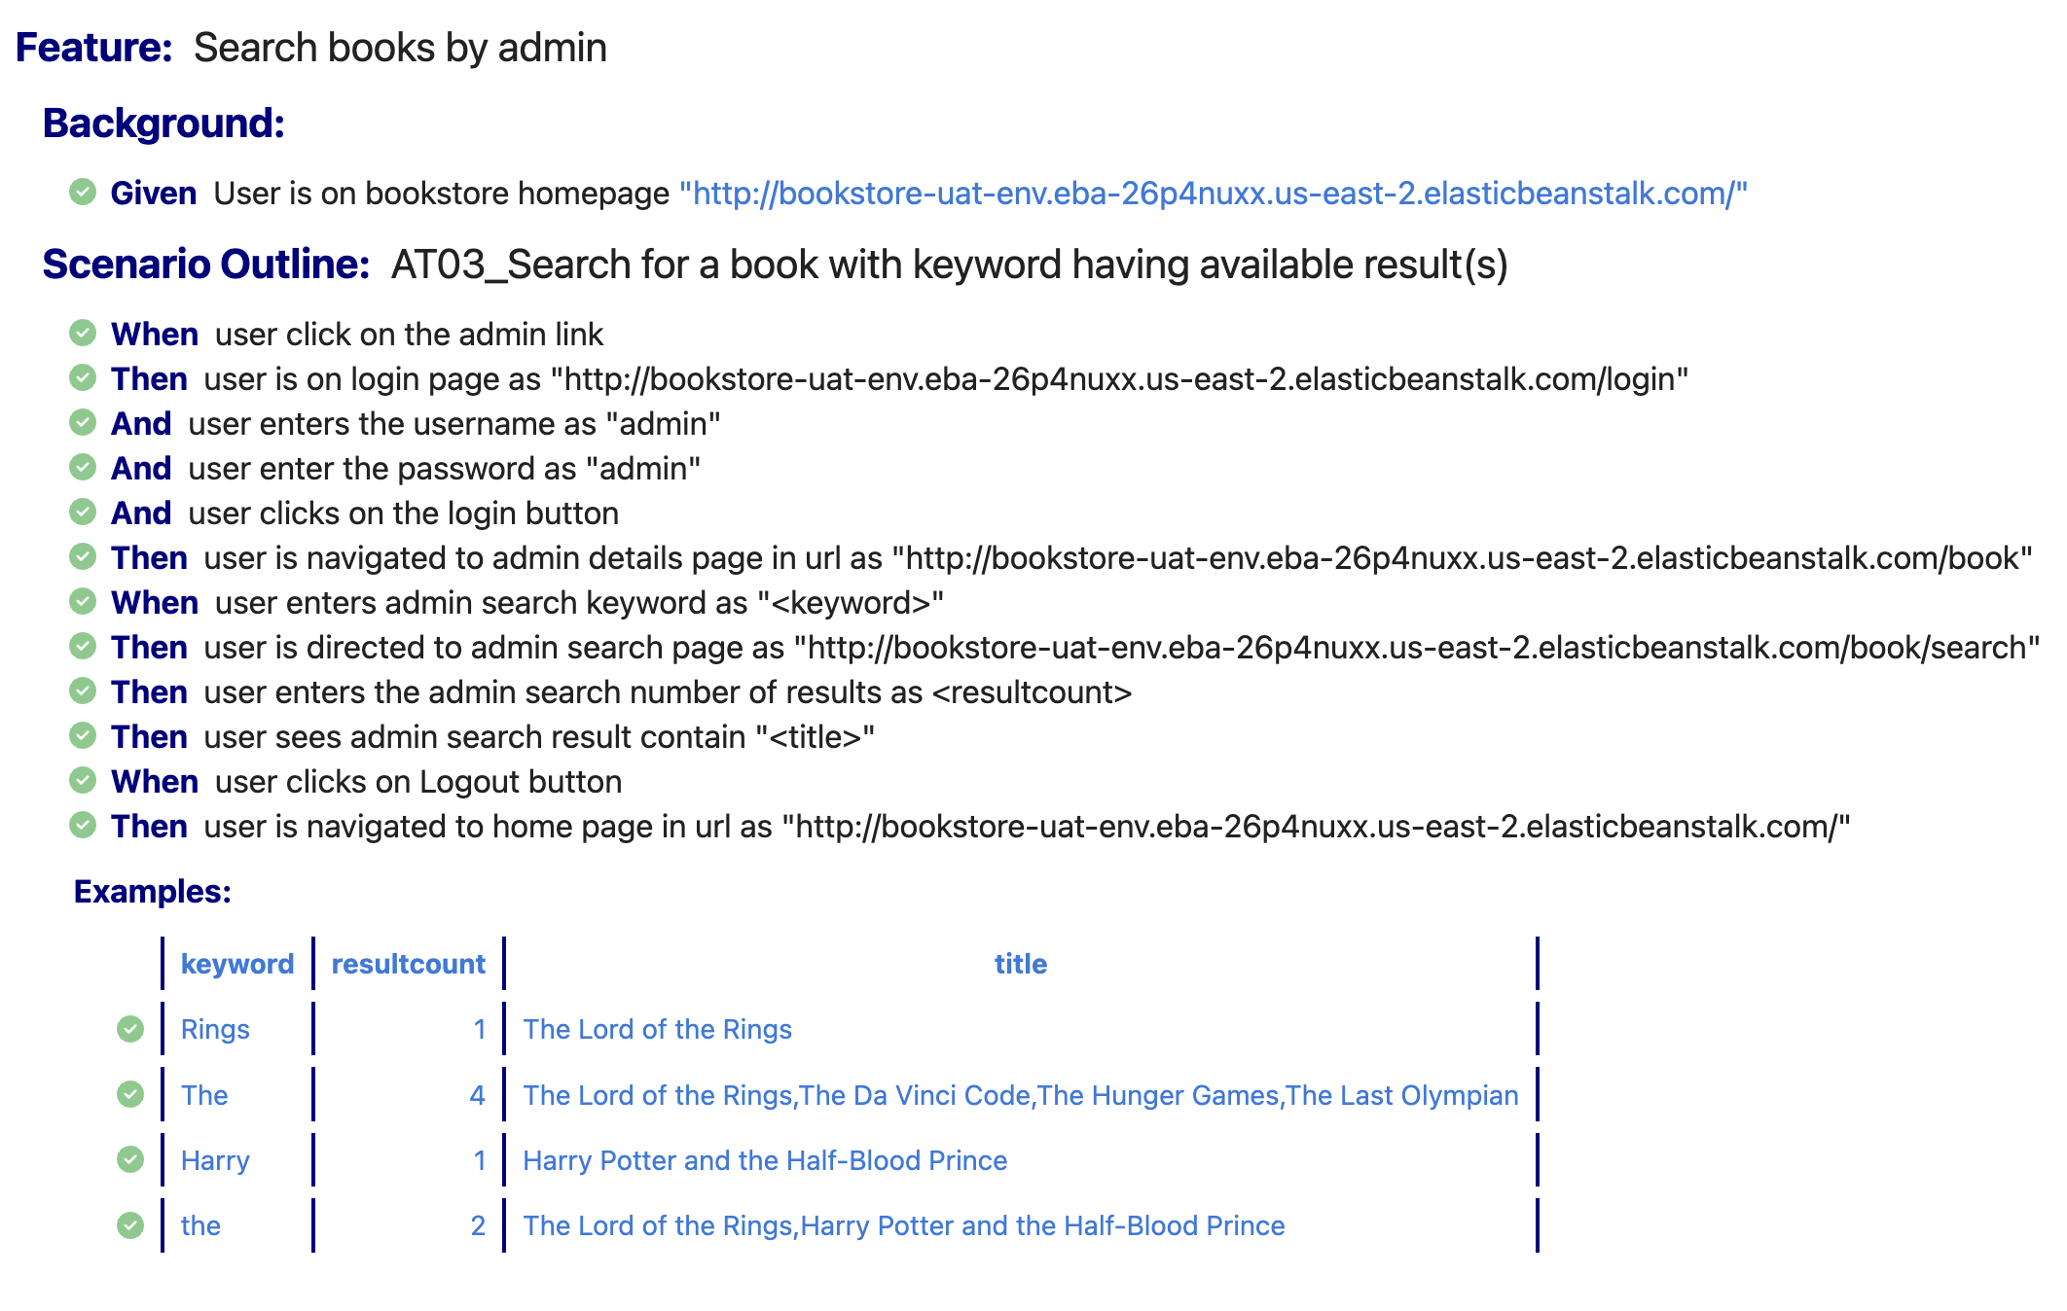
Report 5: Test Case List – Detailed Test Case
TC ID | Function Name | Result
AT01 | Admin log in with incorrect credentials | Passed
AT02 | Admin log in with correct credentials | Passed
AT03 | Admin search with available result | Passed
AT04 | Admin search with no results | Passed
AT05 | Admin add new book success | Passed
AT06 | Admin add new book failure | Passed
AT07 | Admin edit book details | Passed
AT08 | Admin delete book | Passed
AT09 | Admin log out | Passed
AT10 | User search with available results | Passed
AT11 | User search with no results | Passed
AT12A | User adds single product to cart | Passed
AT12B | User removes from cart | Passed
AT13A | User adds multiple products to cart | Passed
AT13B | User deletes all from cart | Passed
AT14A | User checks out when there is one book in cart | Passed
AT14B | Admin view order details with one book in cart | Passed
AT14C | User checks out when there are two books in cart | Passed
AT14D | Admin view order details with two books in cart | Passed
CICD01 | Change app codes – automation Passed | Passed
CICD02 | Change app codes – automation Failed | Passed
CICD03 | Change Automation code – Test Passed | Passed
CICD04 | Change Automation code – Test Failed | Passed
CICD05 | Trigger Redeployment - Manual Release | Passed
CICD06 | Change AWS infrastructure configuration (Add new environment) | Passed
CICD07 | Change AWS infrastructure configuration (production EC2 counts) | Passed
CICD08 | Change AWS infrastructure configuration - Deploy to new AWS account | Passed

Slide 20
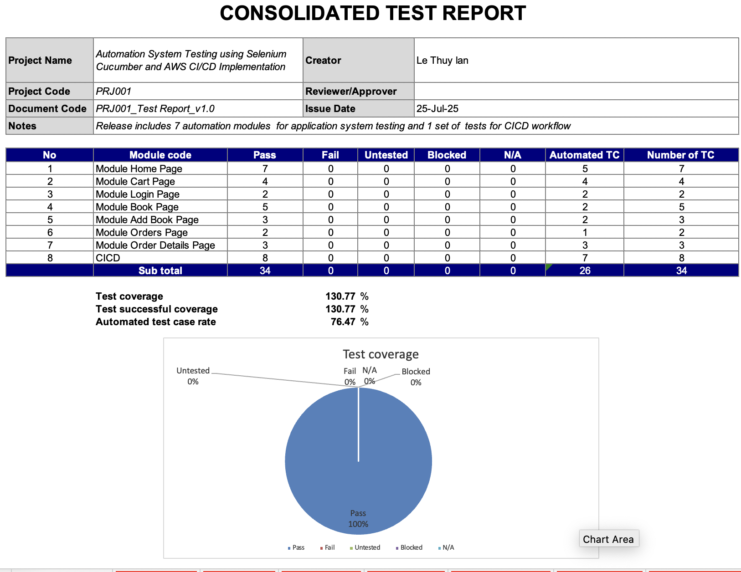
Report 5: Consolidated Pipeline Test Report

Slide 21
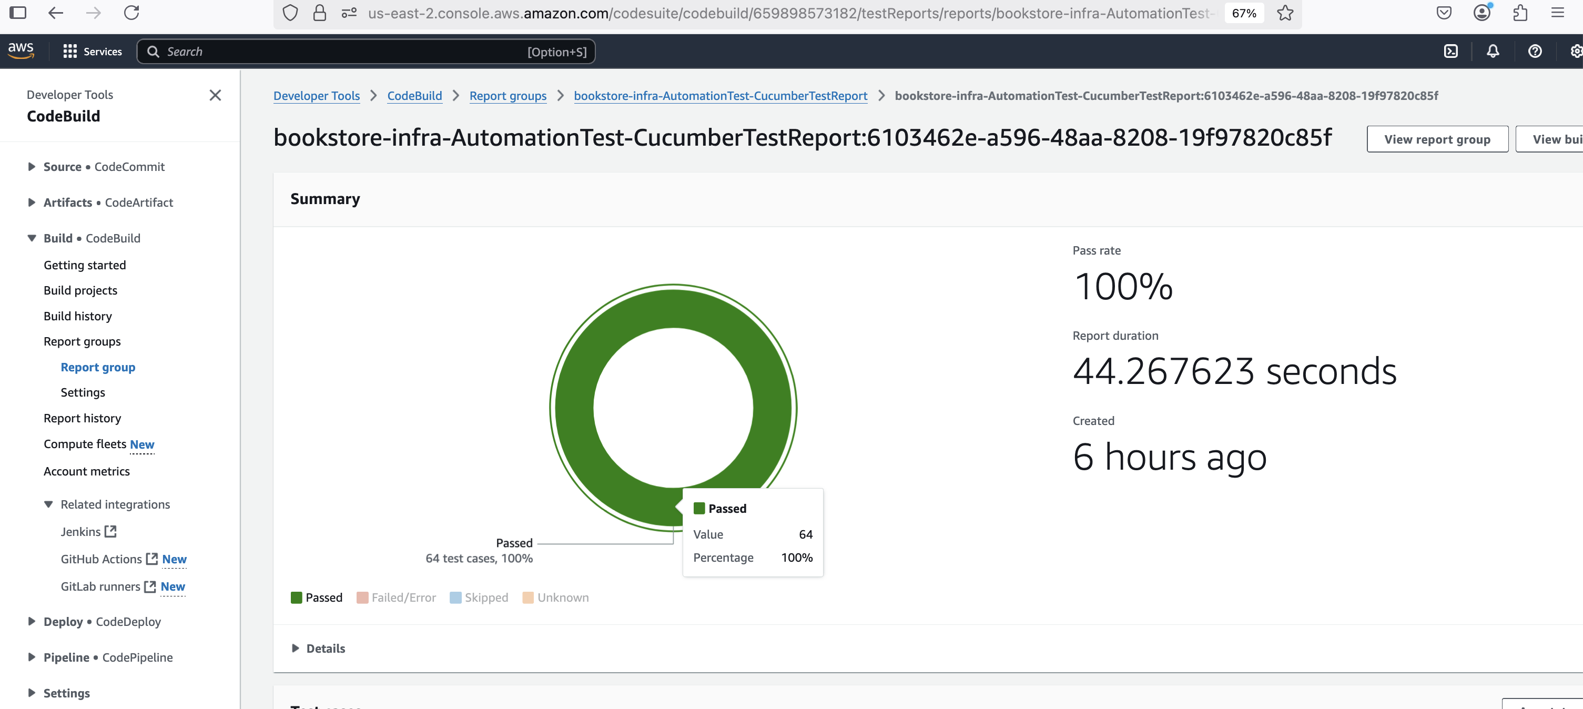
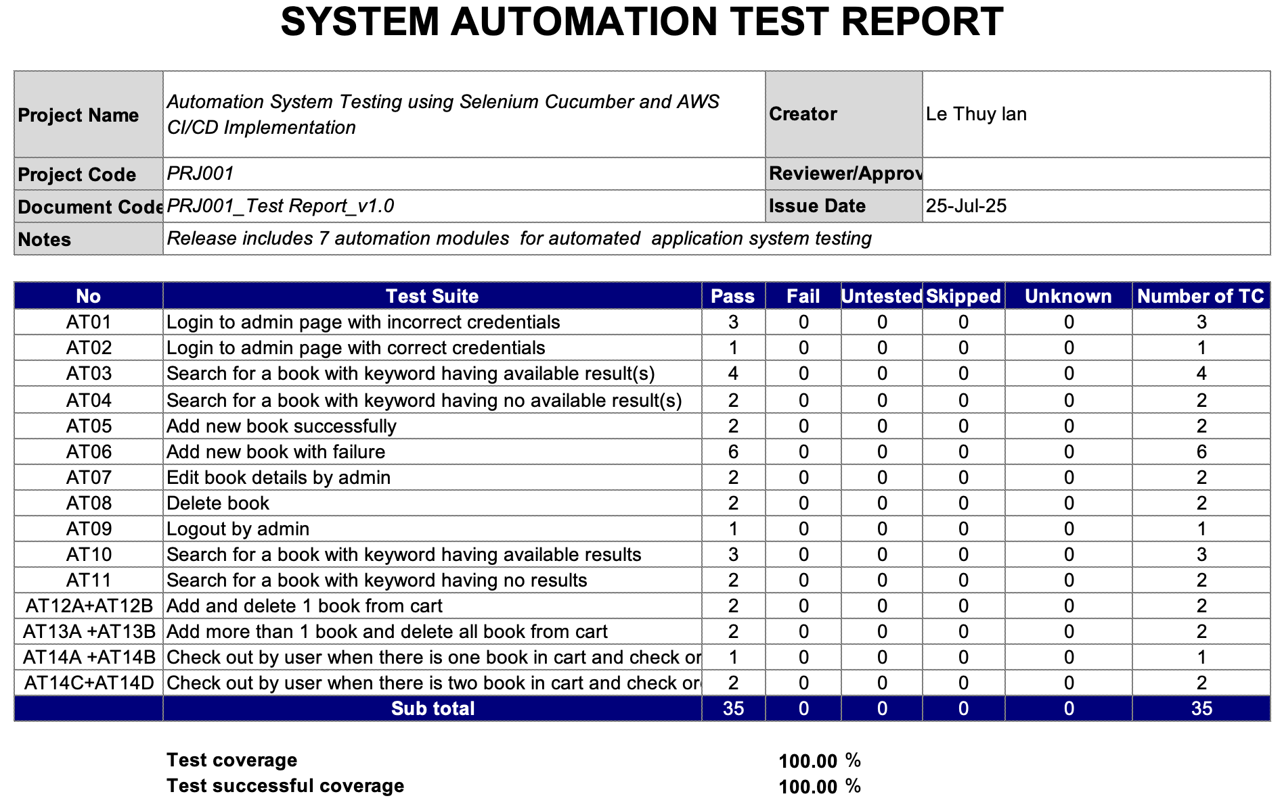
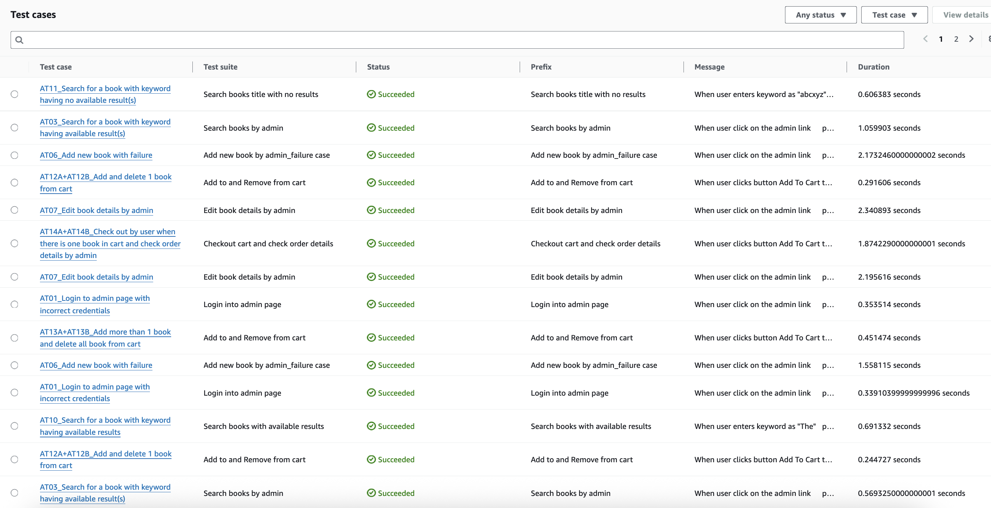
Report 5: AWS Pipeline Automation Test Report

Slide 22
Report 5: Bug Report Sample
Category | Label | Value
BugID | ID number | B01
 | Name | Incorrect example for searchbook_available feature file
 | Reporter | Lan Le
 | Creation Date
Overview | Summary | Feature file has incorrect search keyword
Environment | Operating system, browser | Chrome (137.0.7151.119)
Details | Steps | Run the home_search_available.feature Check report
 | Actual | Incorrect test data and test case failed
 | Expectation | Correct test data and test case passed
Tracking | Severity | Medium
 | Priority | 3
 | Assigned To | Lan Le
 | Status | Closed
 | Resolution | Fixed
 | Resolution Details | Fix the text for feature file to available result

Slide 23

Demo
- CI/CD use case (change application codes - login)
CI/CD use case (change automation testing codes – home search no results)
CI/CD use case (manual approval to deploy to production environment)
Automation use case (search)
Automation use case (checkout and view order details)
Automation use case (admin logs in and add new book)
Automation use case (admin add edit and delete book)

